Slide 1

New York Yellow Taxi Cabs Demand Prediction Project
To help the taxi drivers find the best pickup regions for different times in the city.

Slide 2

Objective
The aim of this project was to utilize machine learning techniques to predict the number of taxi pickups within 10-minute time intervals and different clusters in New York City.
By leveraging past data from NYC yellow taxi cabs, the goal was to provide valuable insights to taxi drivers, enabling them to optimize their routes and maximize their earnings by knowing when and where the most pickups are likely to occur.

Slide 3
Data Collection
We have collected all yellow taxi trip data of jan-2015 and jan-2016 from - https://www.nyc.gov/site/tlc/about/tlc-trip-record-data.page
The datasets were collected and provided to the NYC Taxi and Limousine Commission (TLC).

Slide 4
Data Preprocessing
Firstly, the data was preprocessed to remove missing values.
According to NYC taxi and limousine commission regulations, the maximum allowed trip duration in a 24 hour interval is 12 hours. So, we removed the datapoints where the trip duration was more than 12 hours.
Then, we removed some outliers based on speed, trip distance and fare amount.
Finally, we removed the datapoints where the pickups or drop-off points were outside the New York City range.

Slide 5
Clustering
We used the K-means clustering algorithm to group the geographical locations of taxi pickups into clusters with the following constraints -
We clustered the regions based on the pickup density. (Regions with high pickup density have smaller clusters and regions with low pickup density have larger clusters)
The time interval is of 10 minutes.
A cab travels 2 miles in 10 minutes on average.
The distance between the centroids of two adjacent clusters should be around 2 miles but not less than 0.5 miles.

Slide 6
Time Binning
First, we changed the times to UNIX time format for easier calculation and binning.
Then we binned the timestamps of taxi pickups into 10-minute intervals, creating time bins for analysis.
This granularity allowed for precise predictions of pickup patterns throughout the day.

Slide 7
Smoothing
Pickup counts for some cluster and time bins were missing.
We used smoothing for jan-2015 data since it acts as our training data, and we used simple fill missing method for jan-2016 data where we imputed the missing values with 0.

Slide 8
Modeling
First, we used three baseline models to predict the pickup counts
Simple Moving Average
Weighted Moving Average
Exponentially Weighted Moving Average
We used these baseline models with two variations – using ratios and using past values.
Then, we used multiple regression models for prediction
Linear Regression
Random Forest Regression
XGBoost Regression
We found out that XGBoost Regressor works the best for our case with the mean absolute percentage error of 0.134.

Slide 9
Results
Cluster Identification: Through clustering, distinct geographical areas with high pickup density were identified across NYC, providing valuable insights into the spatial distribution of taxi demand.
Visualization: The clusters were visualized on maps, enabling easy interpretation for cluster centers and pickup densities.
Predictive Accuracy: The trained models demonstrated promising accuracy in predicting the number of pickups within each cluster for different time intervals. This will allow taxi drivers to anticipate peak demand periods and strategically position themselves for maximum earnings.
Conclusion
In conclusion, this project successfully applied machine learning techniques to predict yellow cab taxi pickups in NYC, offering valuable assistance to taxi drivers in optimizing their routes and maximizing their earnings. By providing insights into the temporal and spatial distribution of taxi demand, this predictive clustering approach enhances operational efficiency and improves the overall service quality of NYC yellow taxi cabs.
Future work could involve real-time integration of data and continuous model refinement to adapt to changing demand patterns.

Slide 10
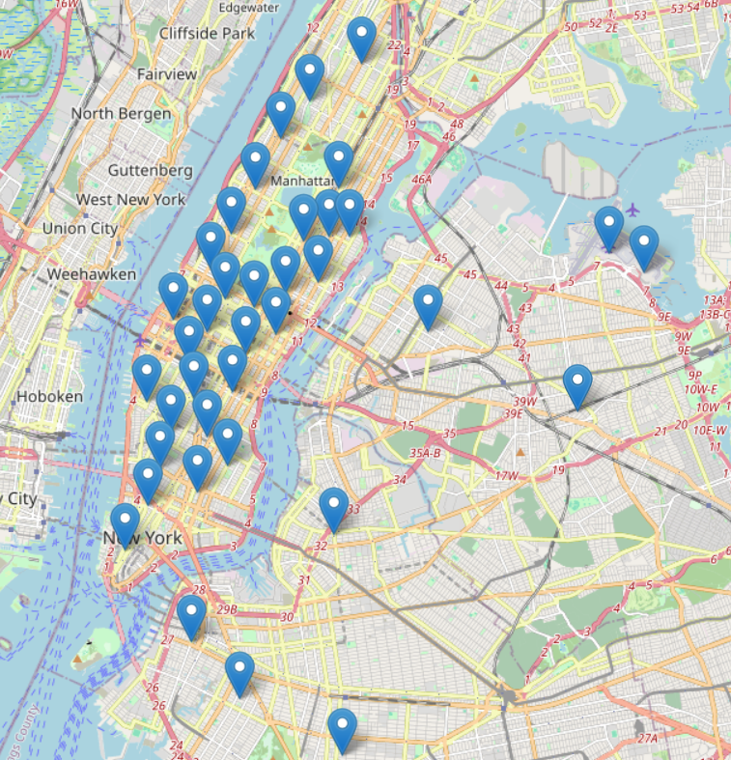
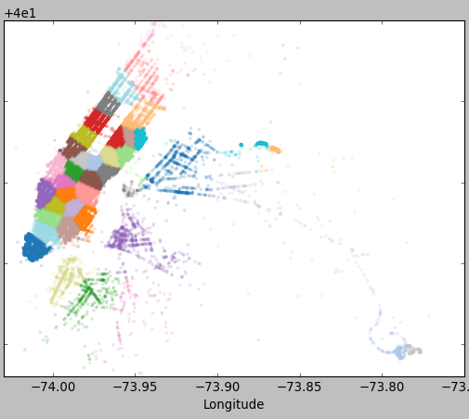
Cluster Centers in NYC

Slide 11
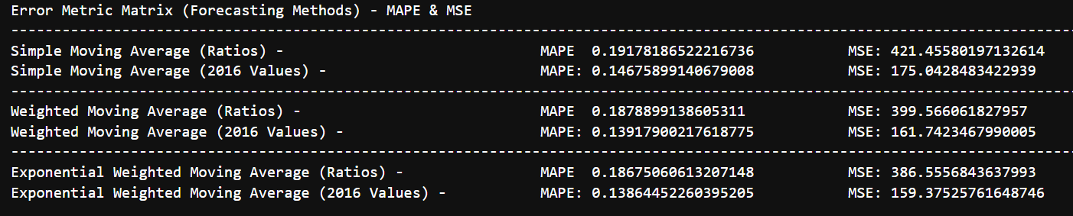
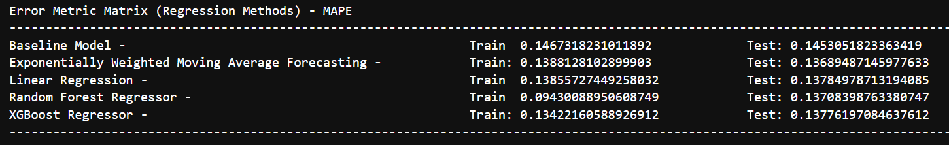
Performance Metrics
Baseline Models
Regression Models

Slide 12





Thank You
Shubham Maindola
+91 90273 73316
smaindola90@gmail.com
www.linkedin.com/in/shubham-maindola

